Slide 1
日米協力 US/Japan cooperation
Research of High Gradient Acceleration Technology for Future Accelerators
2008-2010 progress report
2011-2013 New proposal
7 March 2011
Toshiyasu Higo
Notes:
将来の高電界加速器のための研究開発
日米協力の継続申請

Slide 2
Progress in previous collaboration and proposal in new application
Progress
  2008-2010
  Target
  Result and progress
New application
  2011-2013
  Next target
  Proposals
Notes:
3年の共同研究を経て得られたこと
継続して3年のプログラムの申請をしたい

Slide 3
US/Japan cooperation is a key for worldwide collaboration
SLAC/KEK benefit is very large through US/Japan cooperation and it makes the base for overall framework!
Asian collab.
KEK
Structure fabrication
Infrastructure & test @ Nextef
Tsinghua
Structure design
Structure test and analysis @ Nextef
and others
CERN/KEK collaboration
US-Japan
US-HG
CLIC
SLAC conducts
Structure fabrication
High power test
Basic research
CERN financially supports for
Structure fabrication
High power test
System expansion
Recent test target comes from CLIC
Notes:
日米協力 SLAC・KEK 1990年代～
2006年～ CERN Xバンド高電界開発 関わる ＆ 共同研究体制 構築された
最近では、アジアのラボを含めた共同研究を開始
日米での共同研究はその基礎技術を提供
SLAK/KEKの設備、人材、経験 を有効に使って開発発展させることが 今後の展開のキーになっている

Slide 4
Three year progress
Collaboration framework was reinforced.
Many twin prototype structures have been made in work sharing mode.
Each one of these pairs were high-gradient tested at both laboratories. 80MV/m in copper structure is in our hand.
Basic studies in simple setups were extensively conducted in close collaboration.
Pulse surface temperature rise, one of the most important parameters in the high gradient realization, was identified.
An advanced design of acceleration unit is in progress.
Notes:
3年の共同研究で明らかになってきたこと
TW 80MV/m
パルス表面温度上昇

Slide 5
Who are contributing in what area
Japan
US
Main lab = KEK
  Accelerator high gradient test
    Nextef
  Mechanical engineering center
    Structure cell production
    Test sample production
Discussion and information exchange is important
Main lab = SLAC
  NLCTA high gradient test
    Station 1, 2
  ASTA high gradient test
    Single-cell
    Pulse heating
  Klystron shop
    Structure fabrication
US-HG collaboration
Notes:
これらの知見を得るためにとってきた体制
SLAC＋KEK の二人三脚 体制 キーポイント
情報の交換の場 US-HG 等との関わりが有効

Slide 6
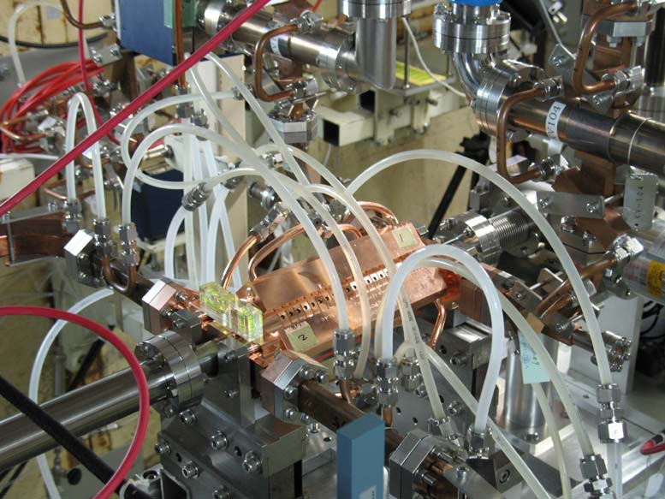
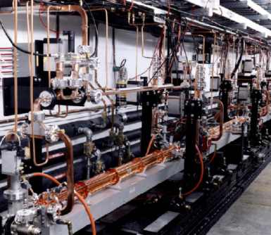
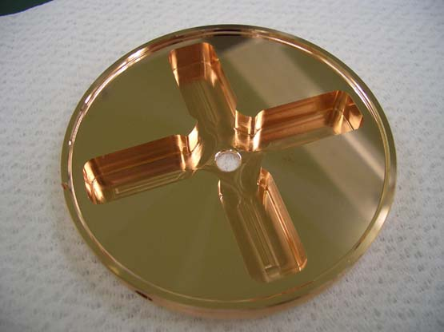
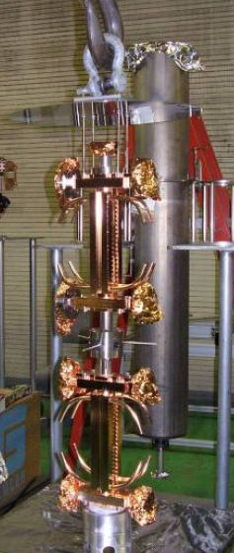
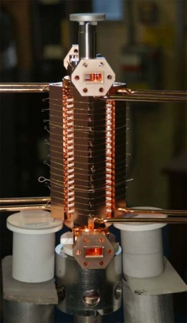
SLAC/KEK prototype test flow
Design for CLIC (CERN)
High power test (NLCTA-SLAC)
High power test (Nextef-KEK)
Fabrication of parts (KEK)
CP (SLAC)
VAC bake (SLAC)
Bonding (SLAC)
Notes:
プロトタイプの試験サイクル
ここでも 日米を基礎におく SLAC・KEK キープレーヤー

Slide 7

Toward 100MV/m
T18
undamped
TD18
Damped
T18 unloaded
100MV/m
TD18 unloaded
100MV/m
Es
Sc
Sc
P (MW), Es (MV/m), Ea (MV/m), ΔT(C), Sc*50 (MW/mm2)
Es
P (MW), Es (MV/m), Ea (MV/m), ΔT(C), Sc*50 (MW/mm2)
Ea
Ea
P
P
ΔT
ΔT
Iris number
Iris number
High Eacc and Es
High Eacc and Es and ΔT
Notes:
TW CLICプロトタイプ 試験 結果
Undamp 100MV/m
Damped → 80MV/m 実現

Slide 8
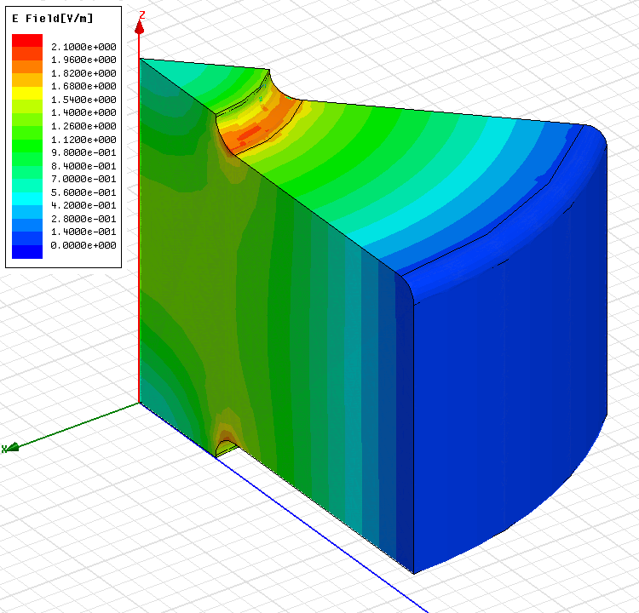
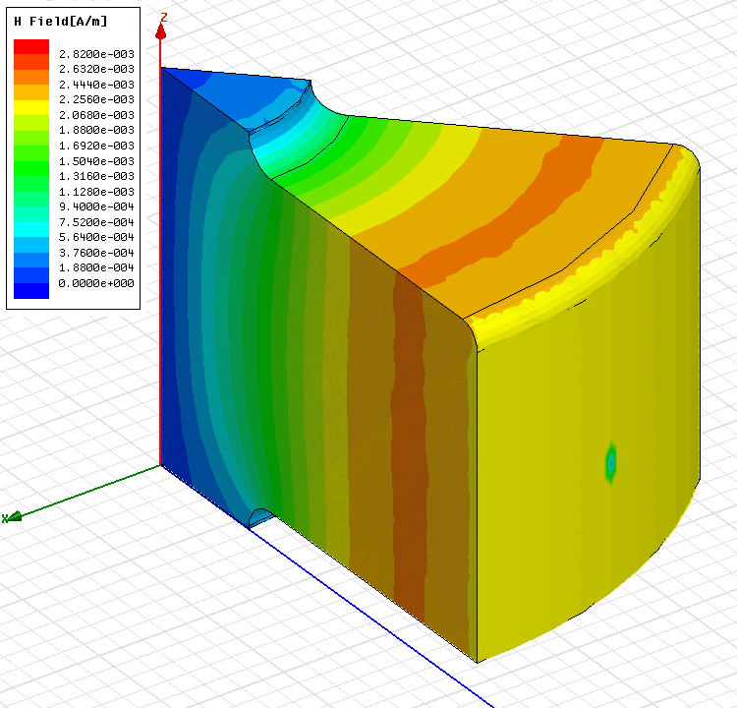
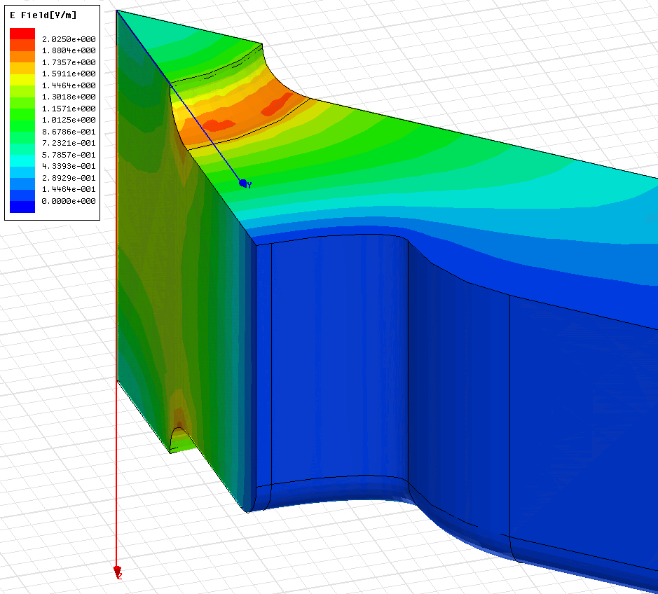
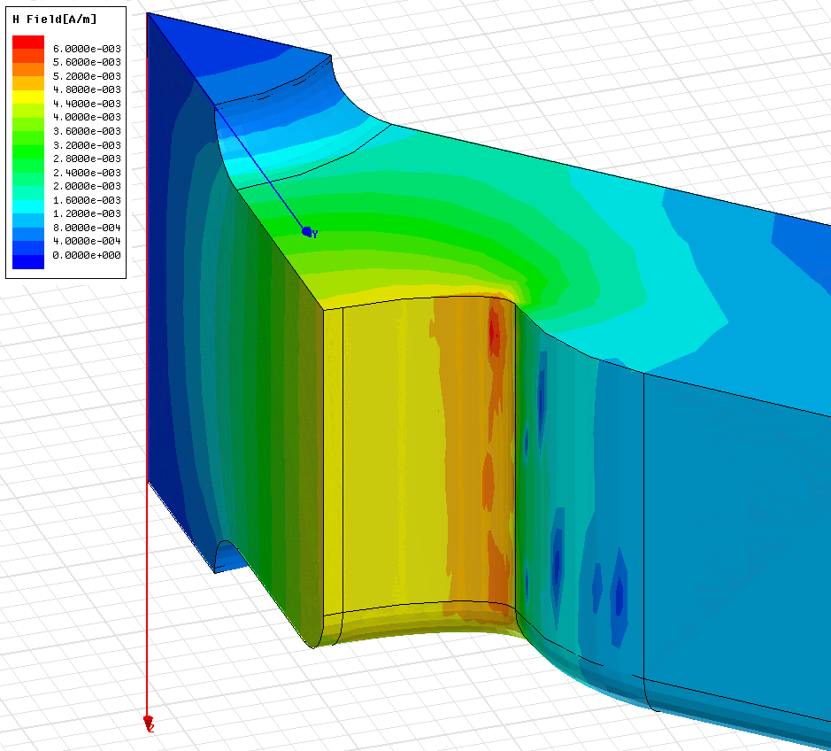
Electric field and magnetic field
Undamped cell
E_{s}/E_{a}
High
H_{s}/E_{a}
Damped cell
Notes:
Damped → ダンピング用切り欠き部 → 温度上昇

Slide 9
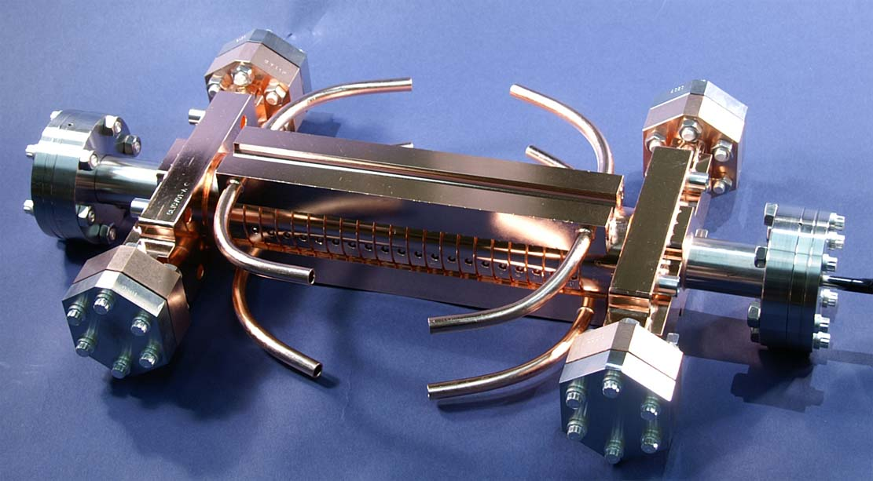

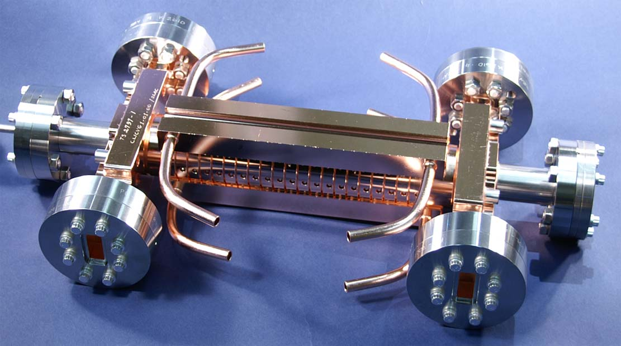
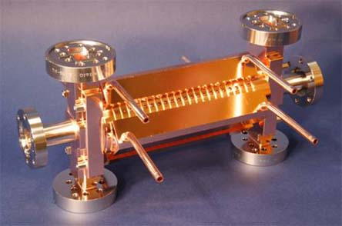
Test structures made as twins
T18_Disk for test at KEK and SLAC
TD18_Disk for test at KEK and SLAC
Notes:
双子の製作
双子 SLAC・KEK で一つずつ試験
比較対象 統計

Slide 10
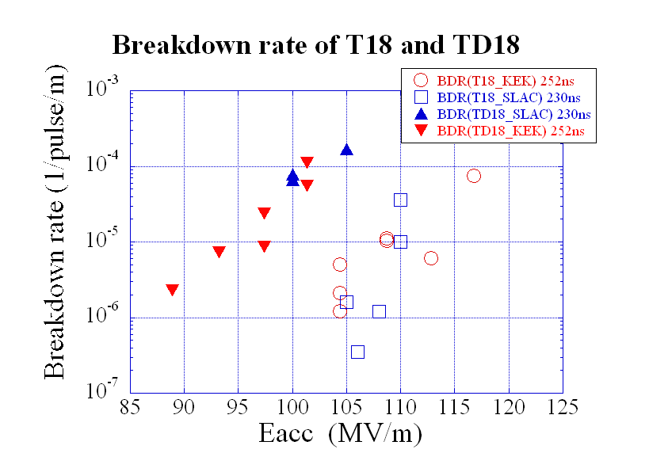
To meet BDR requirement for CLIC
Damped up to 80MV/m
Undmaped > 100MV/m
Damped
Undamped
Notes:
Damped 放電頻度 約100倍
温度上昇か？？

Slide 11
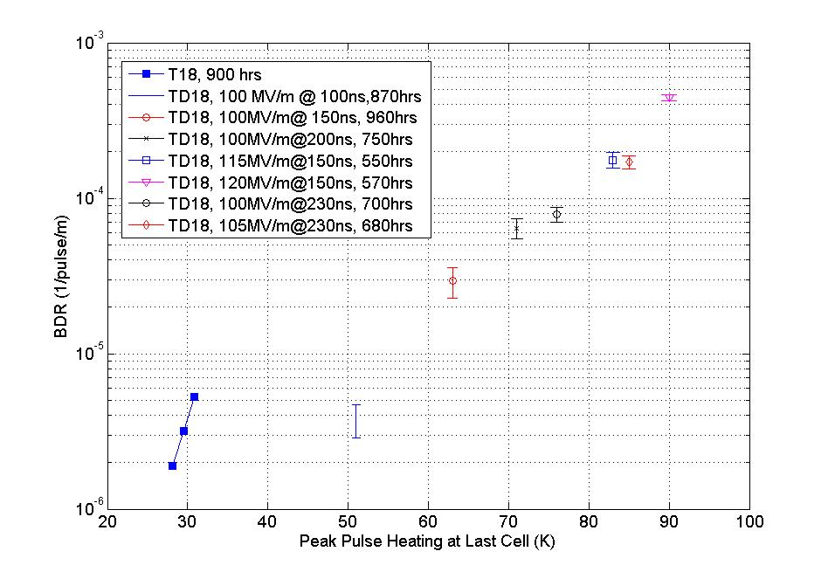
Breakdown rate vs ΔT
Faya Wang
TD18 BDR versus ΔT (pulse temperature rise)
BDR
Damped
Undamped
ΔT
BDR closely correlates to pulse temperature rise even at various accelerator gradient levels
Notes:
温度上昇をパラメータとすると
放電頻度が統一的に見えてきた

Slide 12
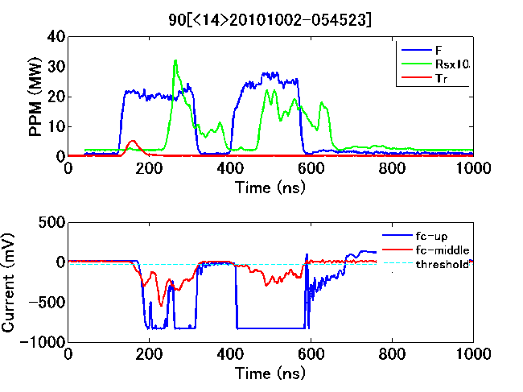
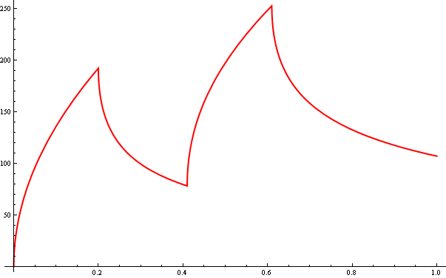
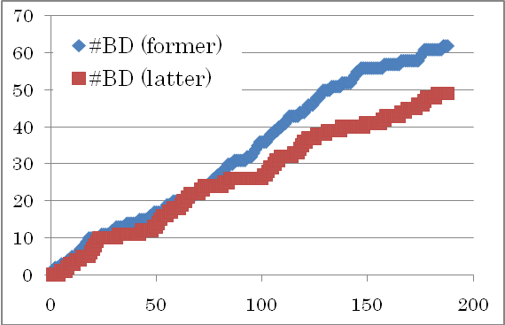
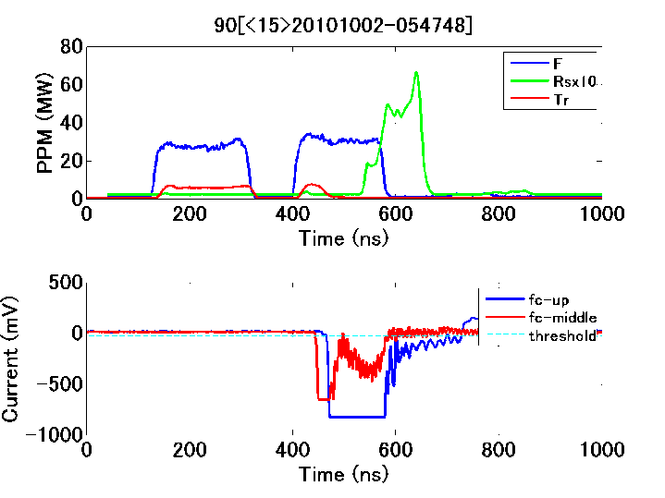
Breakdown rate in double pulse
Pulse temperature rise
時間
Equal BDR even with higher pulse temperature rise at latter pulse.
BDR does not depend on instantaneous temperature rise.
Notes:
温度上昇がキー？
KEK Nextef ダブルパルス試験 温度上昇は後方のパルスの方が高い → 放電頻度は後方パルスが高いか？
結果 放電発生タイミング 頻度はほぼ同じ
つまり、
放電頻度を決めているのは、最大温度上昇らしい
パルス内での時間で変化する実際の表面温度上昇ではないらしい

Slide 13
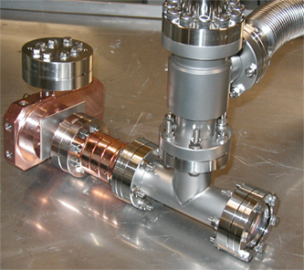
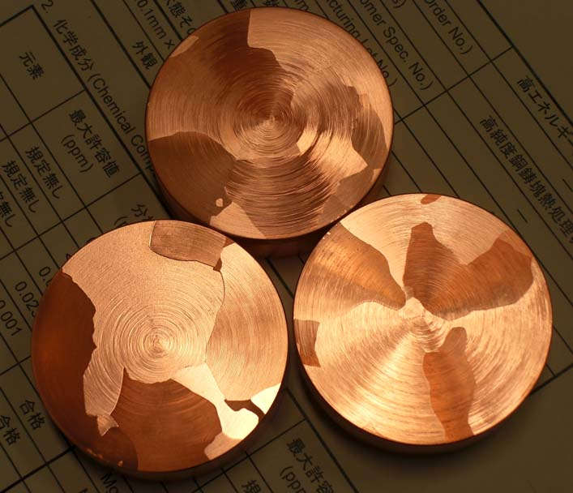
Basic studies
Many of the test assemblies were supplied by KEK and tested at SLAC
Prepared in clean environment
Using pure material
Single-cell test
Notes:
プロトタイプ試験 → 放電のメカニズムを理解すべきである
単セル空洞での試験
KEK 試験体 製作 SLAC ASTA 試験
セル構造
クリーンな製作
材料純度の違い
高温処理の違い
等を変えて調べる

Slide 14
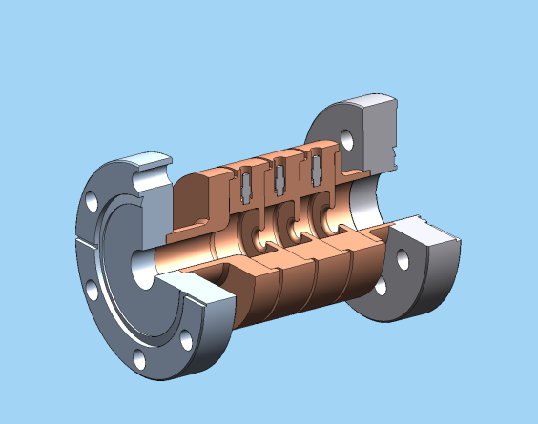
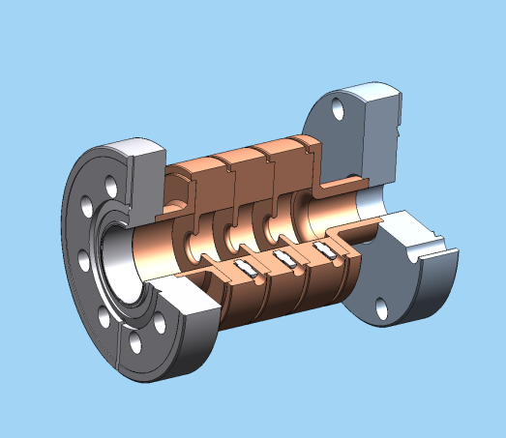
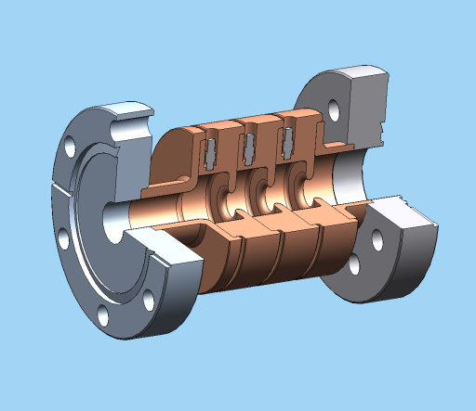
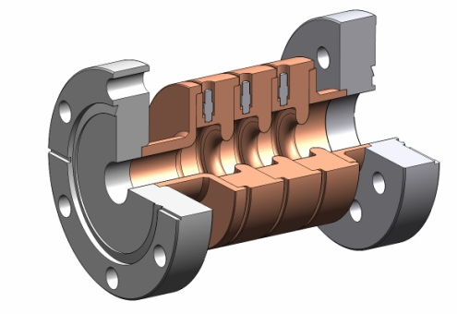
Geometries of four single-cell-SW structures
V. Dolgashev, AAS 2010
1)1C-SW-A2.75-T2.0-Cu
2) 1C-SW-A3.75-T1.66-Cu
3) 1C-SW-A3.75-T2.0-Cu
4) 1C-SW-A5.65-T4.6-Cu
Notes:
構造の違い

Slide 15
V. Dolgashev, AAS 2010
Breakdown rate for 5 single cell SW structures
1C-SW-A2.75-T2.0-Cu-SLAC-#1 (green empty diamond), 1C-SW-A3.75-T1.66-Cu-KEK-#1 (black solid circle),
1C-SW-A3.75-T2.6-Cu-SLAC-#1 (blue empty triangle), flat part of the pulse 200 ns, and
1C-SW-A5.65-T4.6-Frascati-#2 (red empty circle), and 1C-SW-A5.65-T4.6-Cu-KEK-#2 (red full diamond) ), flat part of the pulse 150 ns
Surface electric field
Magnetic field
Pulse surface heating
Accelerator gradient
Peak pulse heating plays an important role, rather than geometry.
Notes:
どの構造でも
単純なパルスでは
磁場、又は相当する温度上昇 のみで 放電頻度が決まっている
但し、 150MV/m 級の加速電界、放電頻度は非常二大きい 場合の特徴である

Slide 16
Breakdown rate vs. pulse heating for three A3.75-T2.6 copper structures, one OFC copper, 6N copper treated with HIP, and 7N large grain copper
V. Dolgashev, AAS 2010
Peak pulse heating plays an important role, rather than material property and treatments.
Notes:
セルのクリーンネス、純度、高温処理
等を変えても かわらない！！
どうも温度上昇で全て決まっている といえる面がある

Slide 17
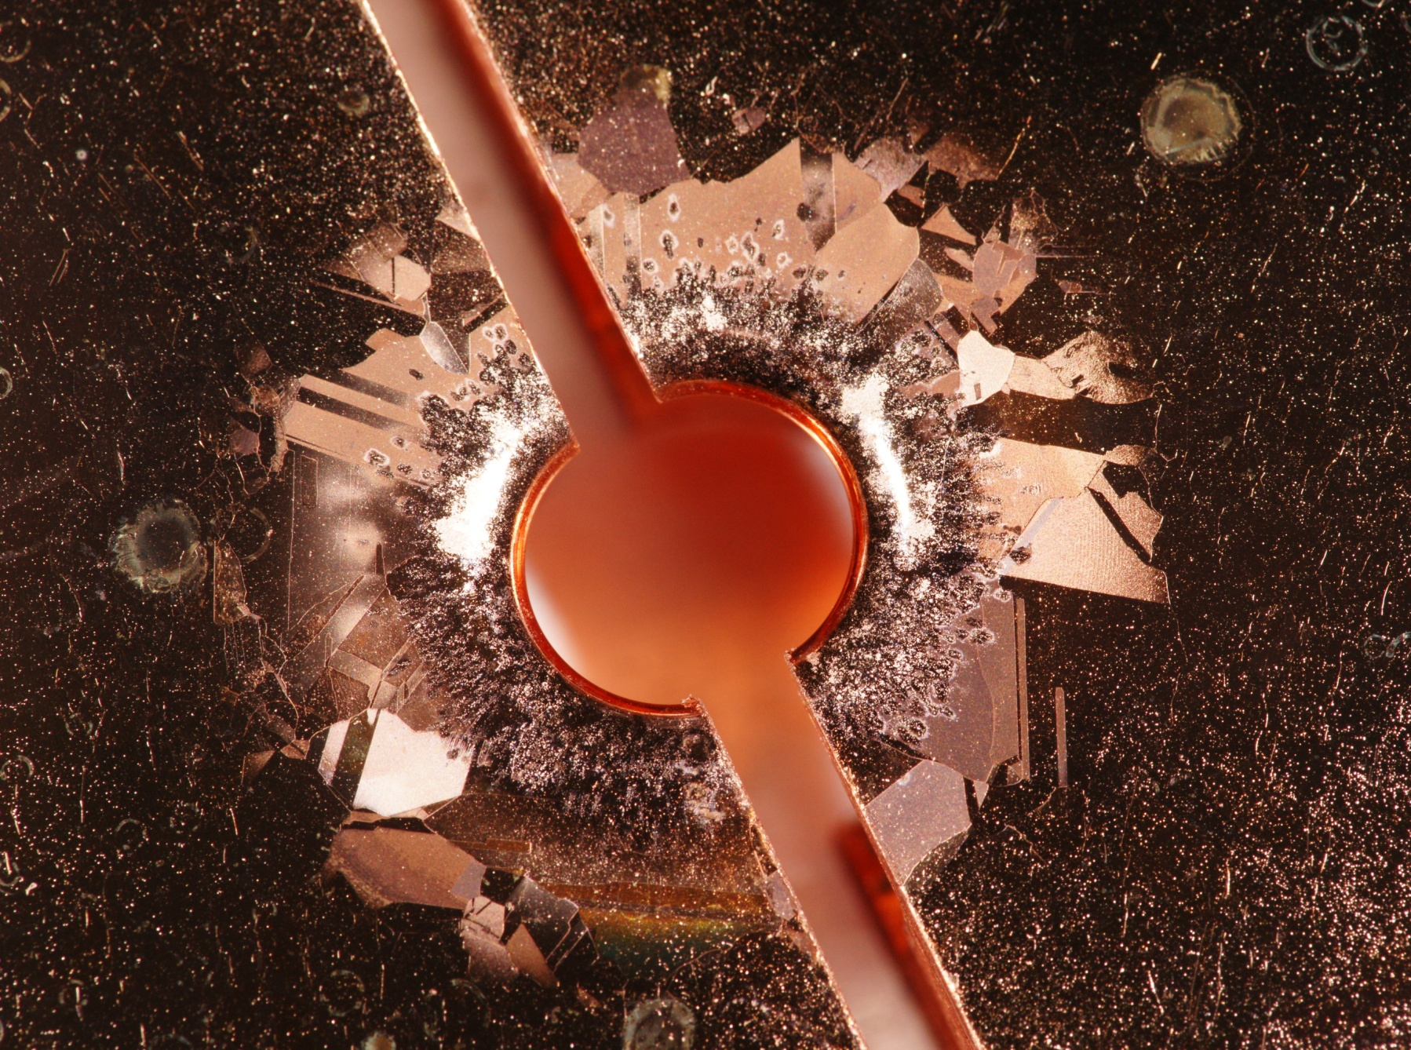
V. Dolgashev, AAS 2010
Flat side of high gradient cell
In addition to discharge pits is seen the crystal pattern due to crystal orientation induced by pulse surface heating.
Photo John Van Pelt
Notes:
試験したセルは
アイリス近傍に 放電によるアーク放電ピット 多数
温度上昇があると
外側は結晶構造、方位による表面の荒れのパターンが見える
→ この辺りが、放電頻度を決める因子を持っていると思われる（仮定に過ぎないが）

Slide 18
Toward new application
We think it necessary to understand the physics which triggers breakdown for future application.
Surface pulse heating seems to play an important role.
Further basic studies should be pursued in this respect.
In this respect, our new application is presented in the following pages. Here the effective usage of facilities, human resources and experience of both laboratories are essential.
Actually some are already launched but we want new items to be funded under US/Japan to proceed effectively, extending and expanding the previous collaboration framework.
Notes:
放電のメカニズムを理解したい
頻度を決める因子を取り出す → 抑制策 または 限界を知る
但し、150MV/mに一気に行くのでなく、
まずは ５０→８０→１００MV/m 辺りでじっくり試験
これにより
実際の加速器への理解、設計への貢献が大きい はず
これを展開するために 日米の継続申請を行いたい

Slide 19
On-going and future activities for new target
Target
  Understand basic physics governing breakdowns
  Realistic design at higher gradient
On-going activities
  SLAC made mode launchers for KEK to study with simple setup.
  KEK is preparing a new shield room “B”.
Future activities
  Various trials to understand the breakdown mechanism are planned.
  Unique accelerator unit design is going based on SW configuration.
Notes:
目標
すでに始めている分
今後の展開
放電の理解
100MV/mを越える高電界加速への研究

Slide 20
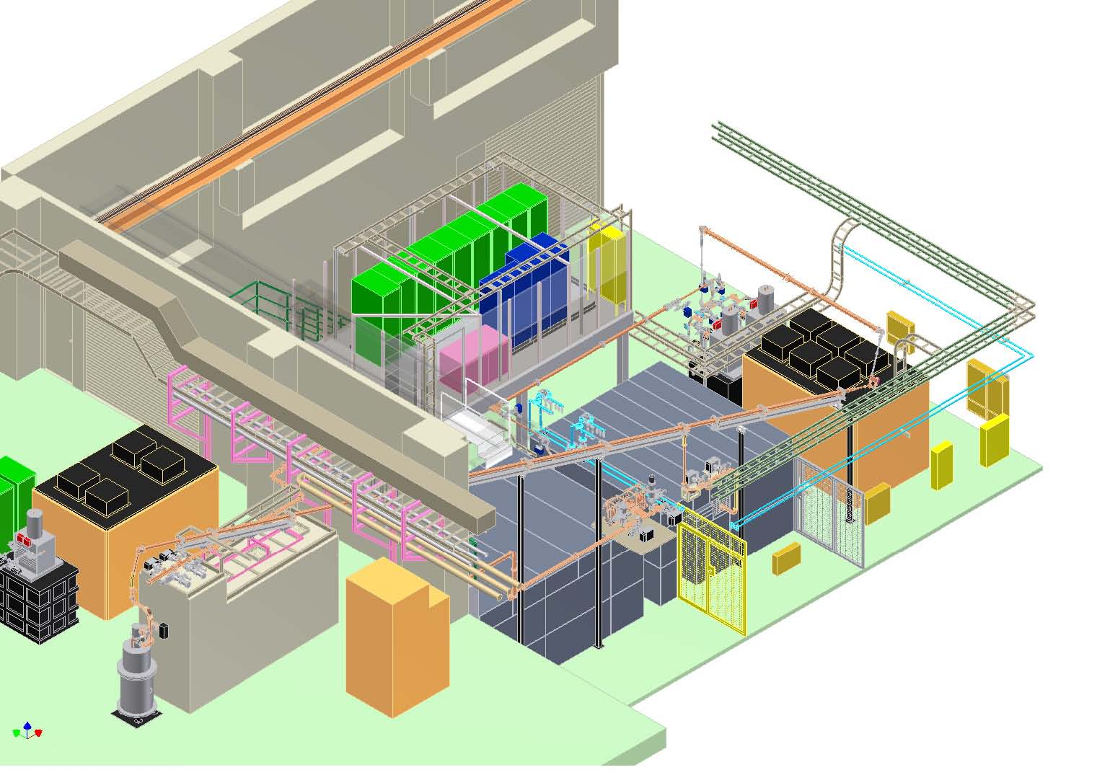
Nextef expansion
Nextef another shield room “B” was being established.
Nextef
X-band
KT-1
X-band
B
A
Notes:
基礎試験設備 ＠KEK

Slide 21
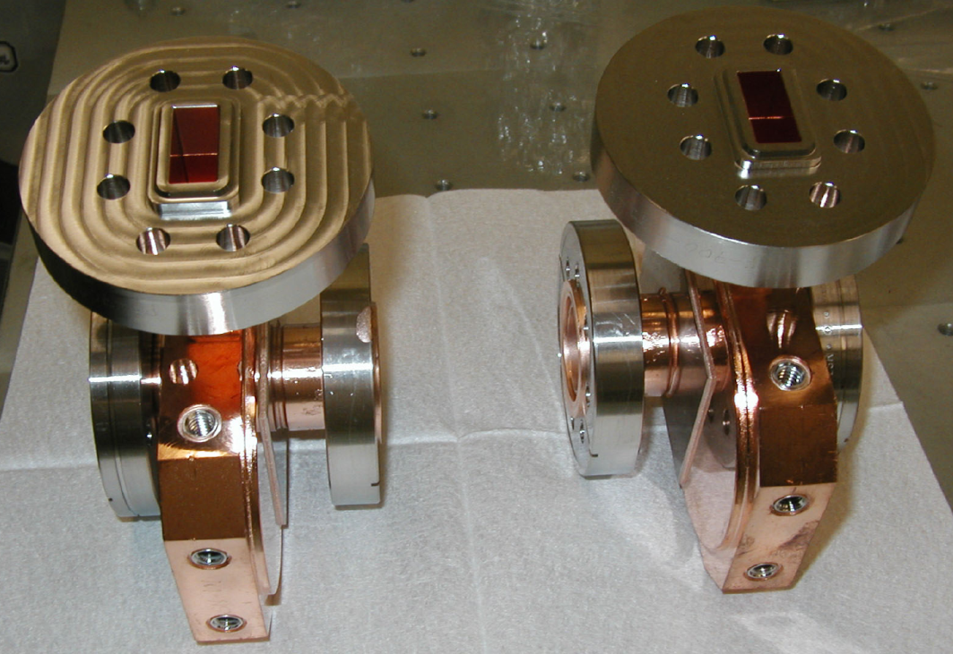
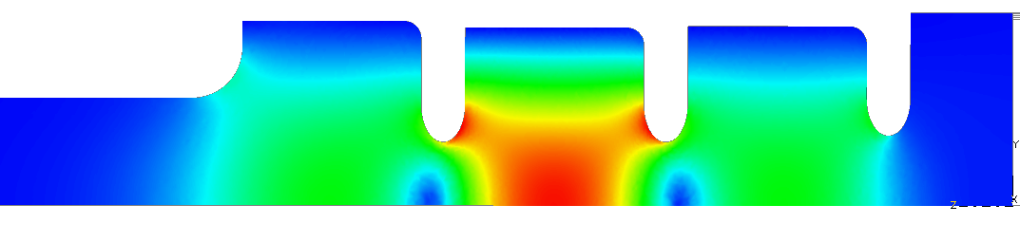
Reusable coupler: TM₀₁ Mode Launcher
Surface electric fields in the mode launcher E_{max}= 49 MV/m for 100 MW
SLAC made these launchers for KEK basic tests.
KEK will prepare single cell test setups.
S. Tantawi, C. Nantista
Notes:
基礎試験用
モードロンチャー SLAC製 → KEKで使用
単セル空洞 を 今後の日米資金と協力関係を元に 製作 ＋ 試験 できる

Slide 22
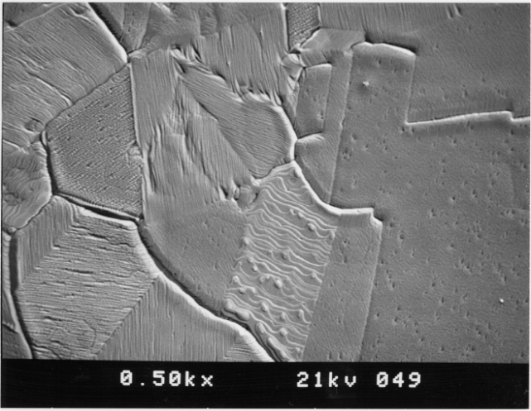
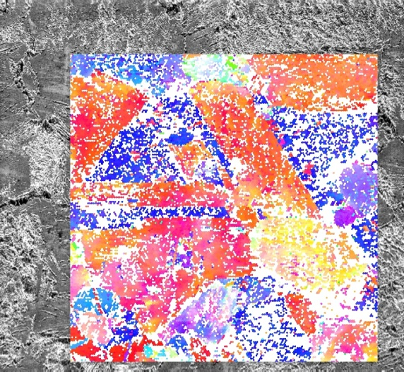
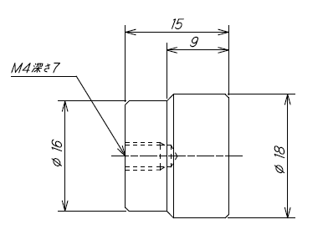
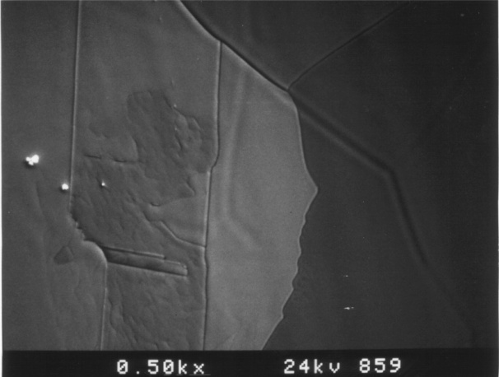
Systematic study on surface treatment is planned in collaboration
Cutting, HIP, purity, heat treatment, CP, EP, etc.
with using LG (high purity large grain material)
in coupon or single cell setup
VAC furnace
Crystal orientation
SEM & X-ray
Field Emission Microscope
Hydrogen furnace
Notes:
特に
結晶構造に着目

Slide 23
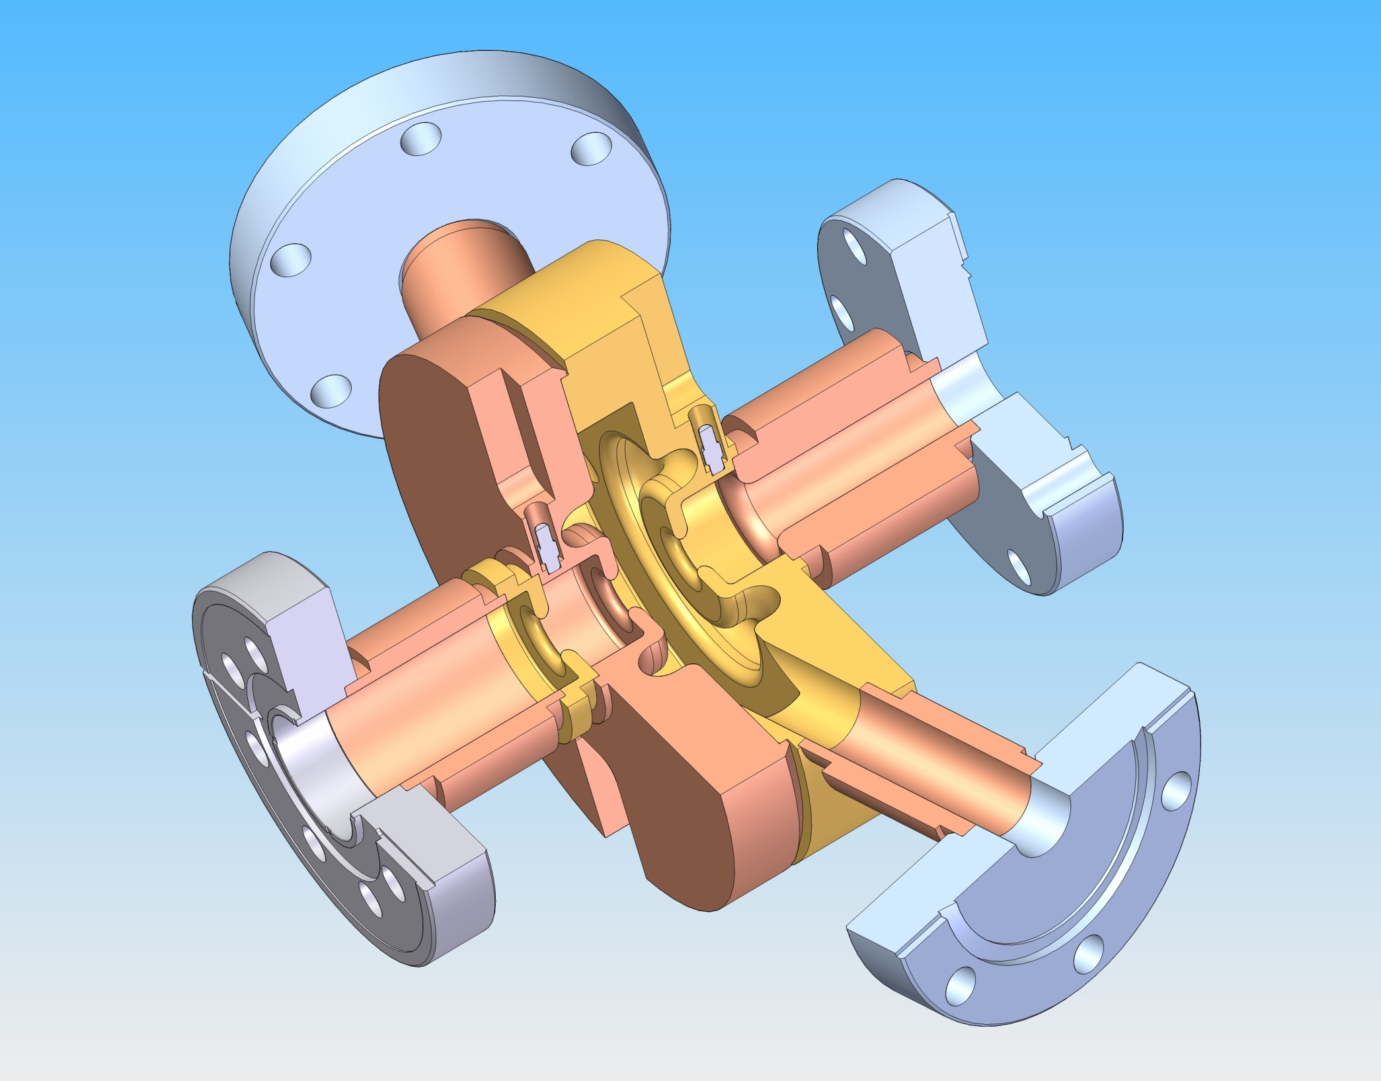
V. Dolgashev, AAS 2010
KEK is preparing in-situ inspection device for single-cell test setup at SLAC.
Solid model by David Martin
A. D. Yeremian et al., “RF Choke for Standing Wave Structures and Flanges,” THPEA065, IPAC 2010, Kyoto, May 2010.
Notes:
SLACの単セル試験
In-situ の表面観測 Processingの理解を深める

Slide 24
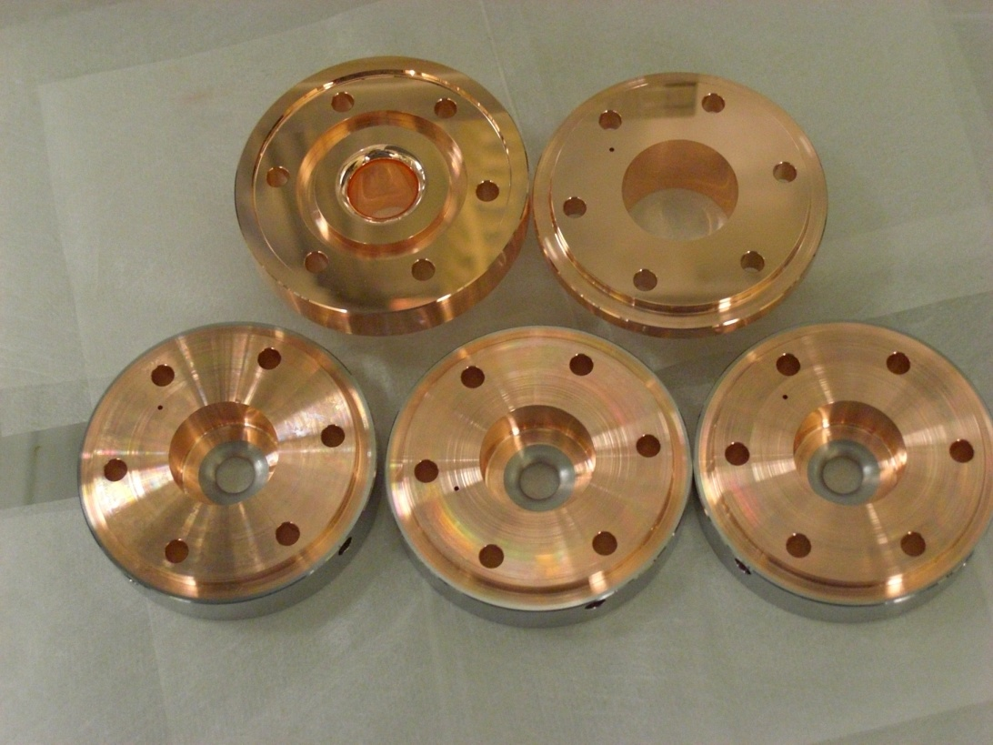
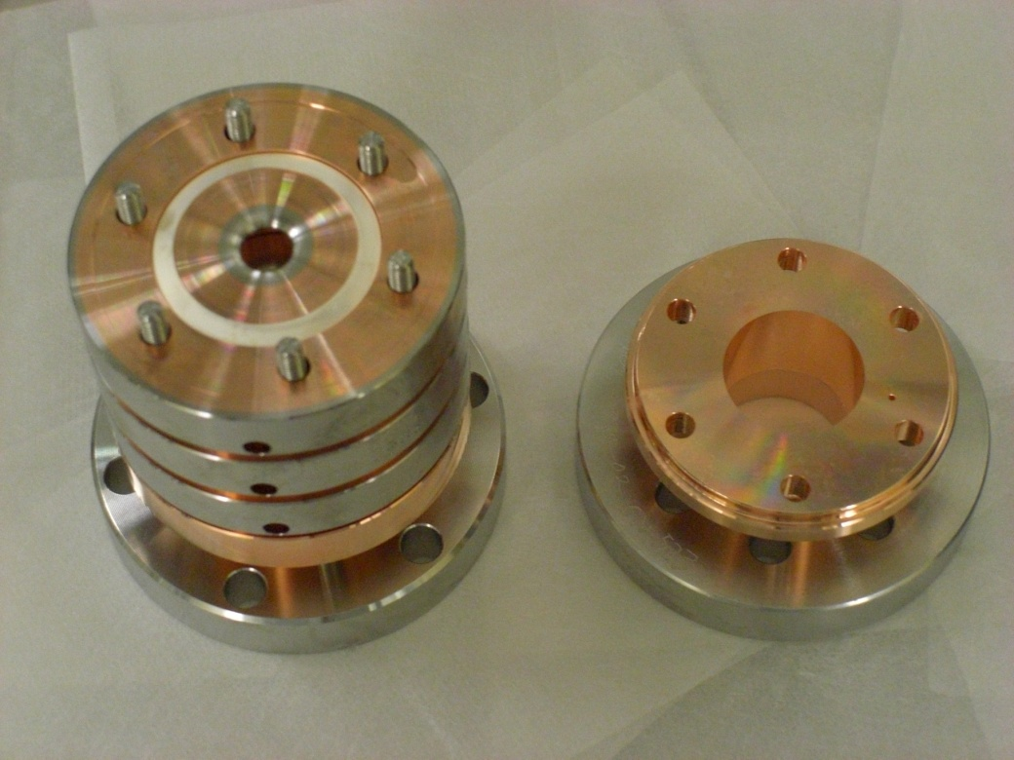
1C-SW-A3.75-T2.60-Cu/Mo-clamped
Test with other materials than copper, such as stainless steel and molybdenum, are being tried for higher gradient.
KEK supplies the test setups.
Notes:
放電しても大丈夫な構造
Mo等のアイリス材料での試験 → 可能なら取り入れて 100MV/m超の電界の実現へ

Slide 25
Approach*
J. Neilson, US HG collaboration workshop, SLAC, Feb. 2011
RF
source
Directional Coupler
Sc = (1 – i + N)^{-1/2}
Load
•
•
•
•
Accelerator
Cavity
N^{th} Accelerator
Cavity
Individually fed π mode cavities
*S. Tantawi,” RF distribution system for a set of standing-wave accelerator structures”, Phys. Rev., ST Accel. Beams,vol. 9, issue 11
SLAC is designing a SW cavity system, each cell fed independently for higher gradient than present prototypes in TW.
Notes:
CLIC Prototyope = TW
SWにして 更に高電界を狙い亡いか？

Slide 26
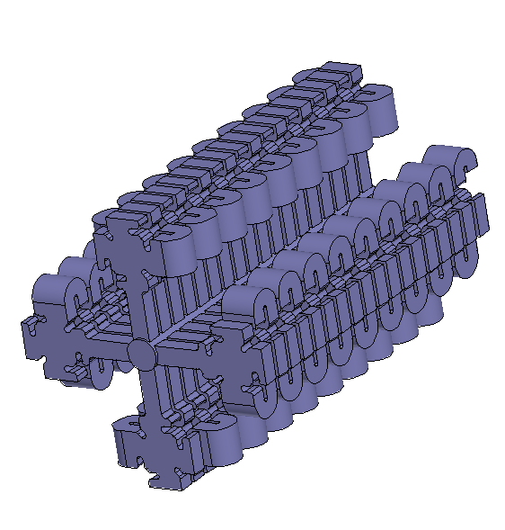
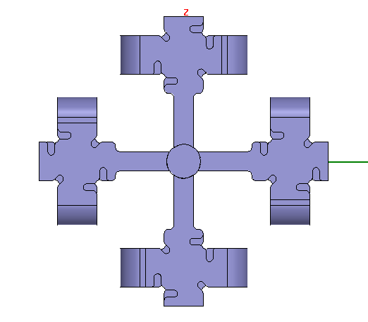
RF Feed Using Biplanar Coupler
J. Neilson, US HG collaboration workshop, SLAC, Feb. 2011
~ 7 cm
~ 3 cm
~ 24 cm
SLAC made a mechanical design and will be tested experimentally.
Notes:
SLACで進めている SW ベースの設計
今後 高電界試験へ進めていく

Slide 27
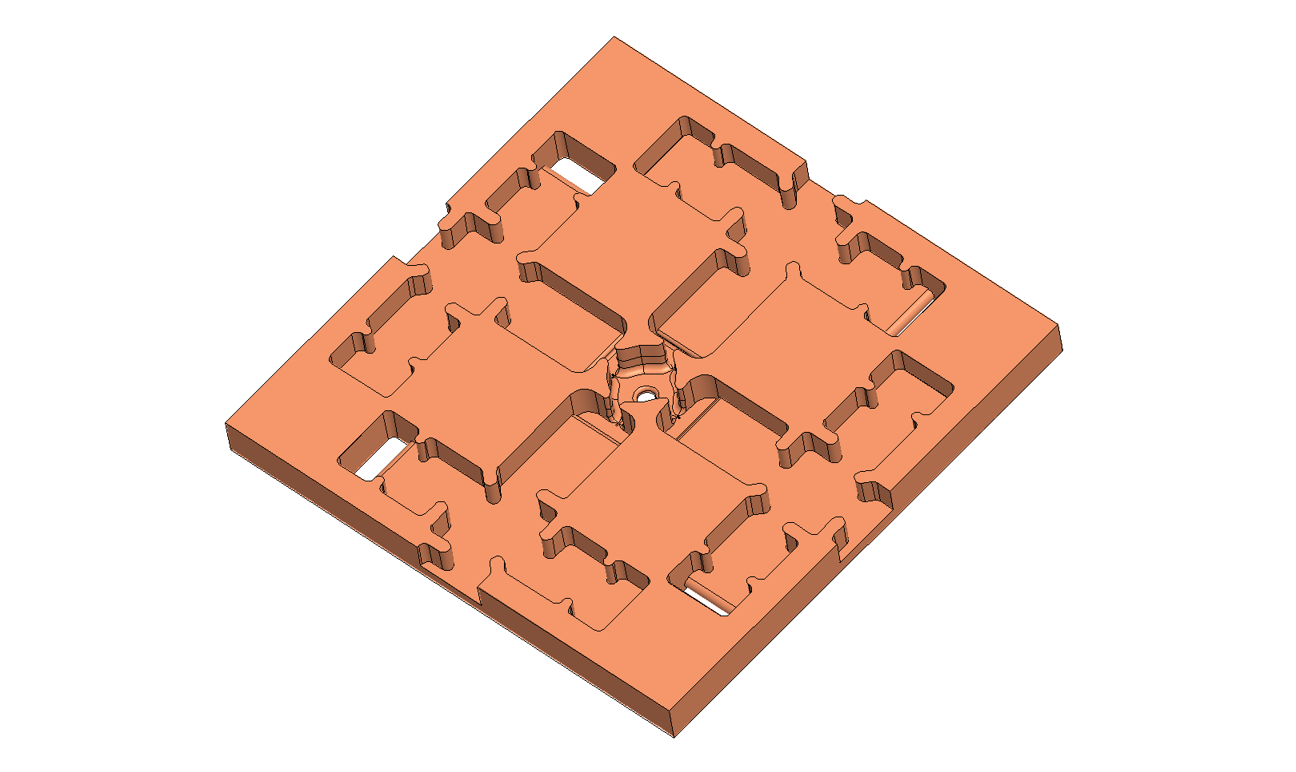
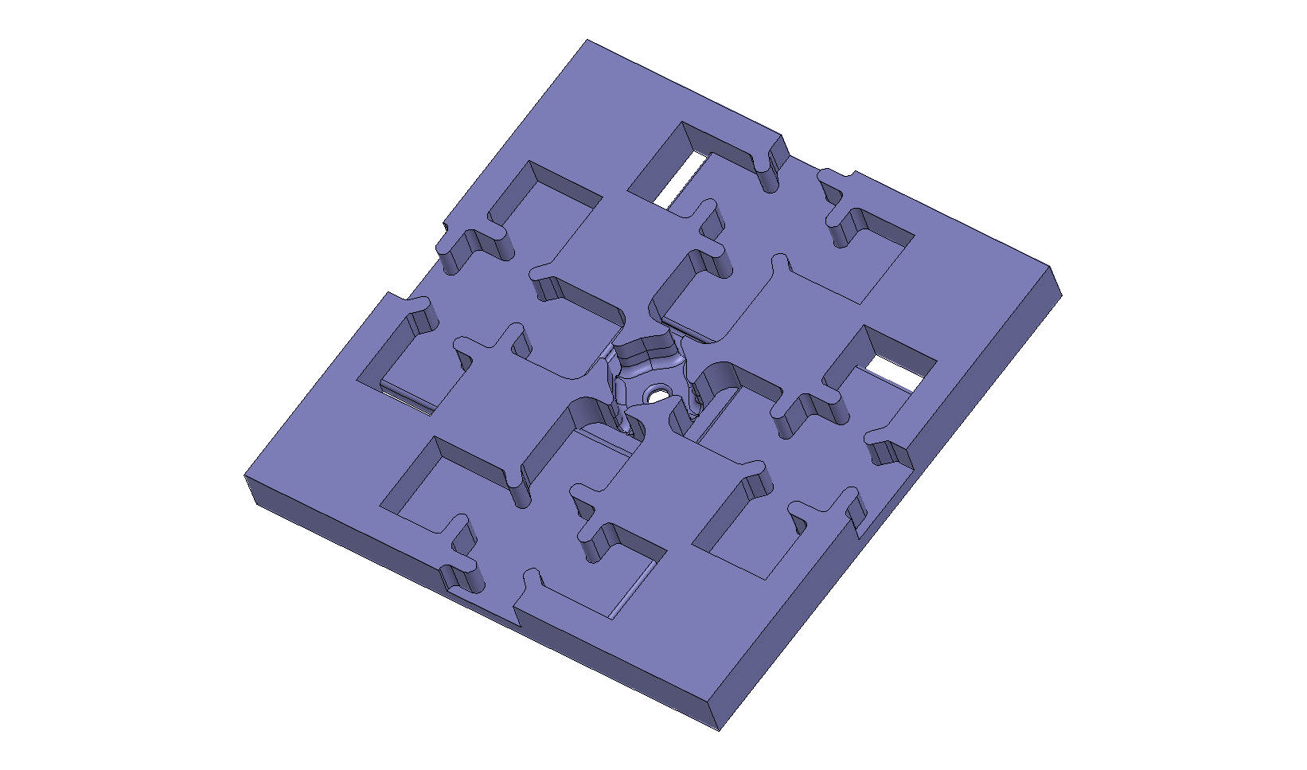
Notes:
ユニット構造

Slide 28
Milestone in summary
2011
  KEK start basic study with simple setup
  Both continue prototype fabrication and evaluation
2012
  Expand the study to application of other material
  Evaluate the feasibility of Cu-based TW prototype
2013
  Hopefully understand the trigger mechanism
  Design a possible higher gradient section for such as linear collider
Notes:
継続申請の3年間の目標 概略
基礎試験の立ち上げ
複合材料を含めた試験
TWでの可能性 見極め
放電頻度を決める放電のトリガーの理解
100MV/m超の加速ユニットの提案

Slide 29
Conclusion
Three year progress were presented.
80MV/m was found feasible in copper TW.
Pulse surface heating was found as one of the most important parameters, especially when going to higher gradient.
Basic studies are proposed to be conducted at SLAC and KEK in a very close collaboration.
This opens the way to understand the physics triggering the breakdowns.
This makes a realistic accelerator design possible at higher gradient than 100MV/m.
Notes:
これまでの3年間
今後の3年間
基礎研究
放電の理解
100MV/m超の加速の可能性

